Slide 1

BEYOND TRAFFIC JAMS:
Innovating for Seamless Mobility in Lagos
Abulatan Ayotola
Chidimma Ezego
Halima Adelaja
Leo Okoh
Orji Ozioma
Nsibietmfon Nsikak
Team Transformers
Notes:
Photo by Nastuh Abootalebi on Unsplash

Slide 2

Lagos, one of Africa's most populous cities, grapples with the pressing issue of high traffic congestion.
This GCGO; Urbanization is now a cause for concern
The problem of high traffic congestion in Lagos matters
greatly as it poses severe implications for the city's residents, businesses, and overall quality of life.
Lengthy commuting times lead to increased
stress levels, reduced productivity,and negative
environmental impact due to excessive fuel
consumption and emissions.
Notes:
Photo by Dylan Gillis on Unsplash

Slide 3




MEET:
Samson Adeleke, a 30 years old male. He is an entry level software developer who lives in Ibafo, Ogun State, and works in Ikeja, Lagos. He earns an annual income of 2.5 million naira; traffic has become the order of the day for him . One very day despite his efforts to wake up early, Samson was delayed in traffic for 8 hours, the frustration of getting to work late led him to quit his job and block out all contact.
Notes:
Photo by Dell on Unsplash

Slide 4
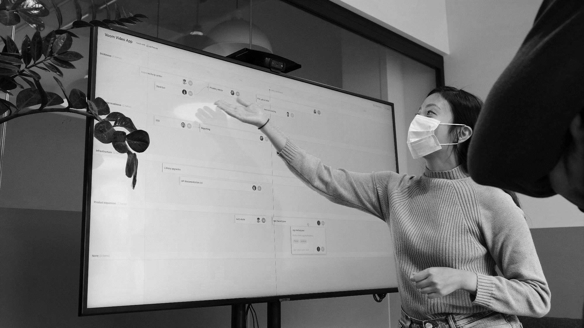
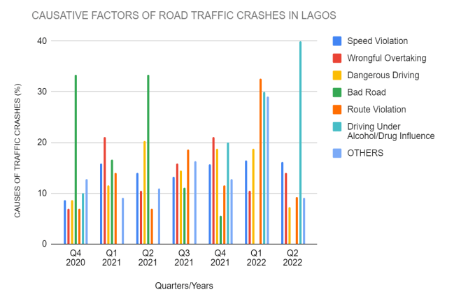
Road crashes in Lagos are often caused by a multitude of factors, contributing to the high rate of traffic congestion in the city. Here we can see how much crashes occured in the last years due to some key factors
Notes:
Photo by airfocus on Unsplash

Slide 5

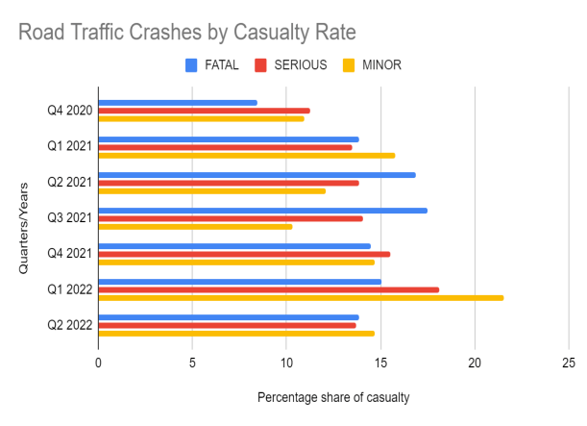
Here we have a comprehensive overview of road crashes in Lagos, categorized by the severity of the crashes: fatal, serious, and minor.
The rate of fatal accident is seen to grow as time goes by; this is a great cause for concern.
Notes:
Photo by Nastuh Abootalebi on Unsplash

Slide 6
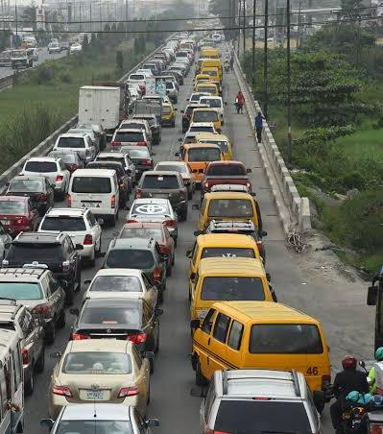
One of the factors affecting Lagos is its continuous growth; In 2006,the city had an average of 224 vehicles per km as against the national average of 11 vehicles per km. In 2009, the Nigeria national average was estimated at 30 vehicles per km, Lagos had moved to 300. In addition, the city has over 1.4 million registered vehicles, and approximately 2.5 million vehicles are on the road daily, weekend inclusive.
Lagos is currently . growing between 7 - . 8% yearly, its . population growth . percentage rate is 10 times faster than those of New York and Los Angeles cities in the United States of America.
It currently accommodates 40% of the total registered vehicles in Nigeria.
Notes:
Photo by Dell on Unsplash

Slide 7
OUR PROPOSED SOLUTION
Develop an app that people can use to share areas of congestion and Real-time traffic information such as road closures, accidents and traffic jams.
The proposed solution of developing this app, holds significant potential in addressing the traffic problem in Lagos. The app would enable individuals to actively contribute to a collective database of traffic information, fostering a sense of community collaboration and shared responsibility. By harnessing the power of crowdsourcing, the app would provide up-to-date and accurate information on the current state of roads, allowing users to make informed decisions about their routes and potentially avoid areas of congestion.
Notes:
Photo by Nastuh Abootalebi on Unsplash

Slide 8

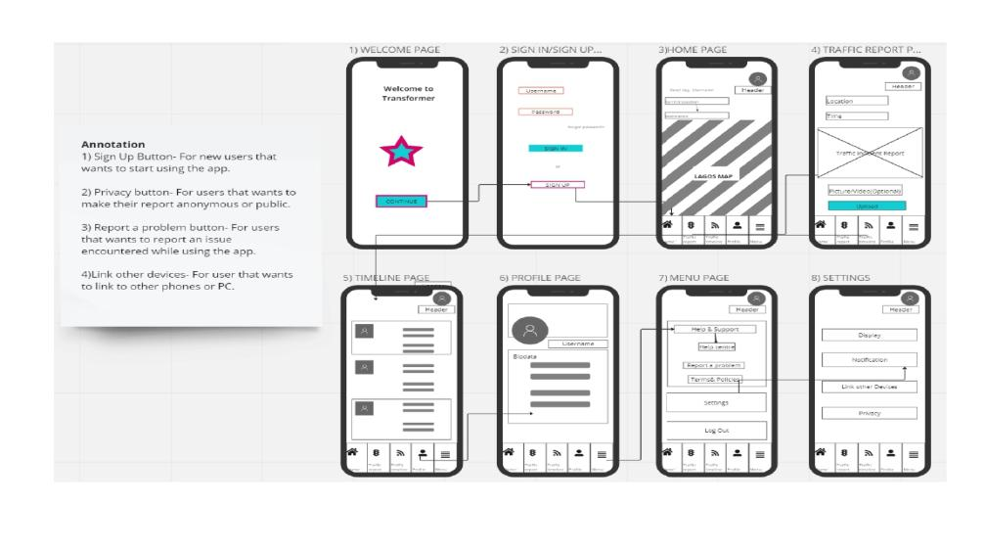
Notes:
Photo by Christian Perner on Unsplash

Slide 9

Concerning our solution,
One pain point raised by users is the reliance on user-generated data for acquiring real-time traffic information.
Another pain point is that non-techy user may find the app's user experience difficult to navigate and understand, posing a challenge in effectively utilizing its features.
Notes:
Photo by LYCS Architecture on Unsplash

Slide 10
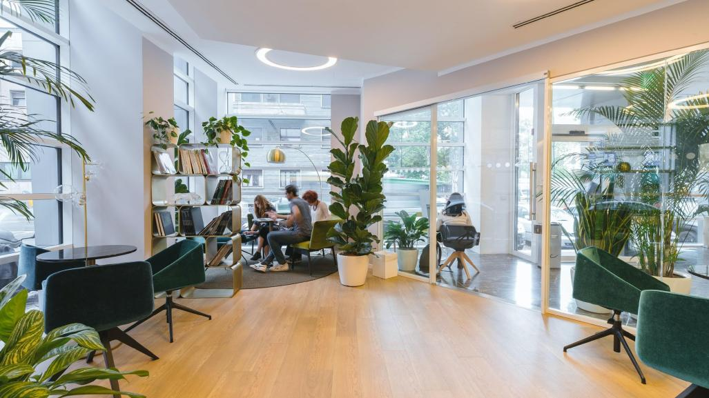
To solve this our team would
Establish mechanisms to verify user-generated reports. This will include user feedback systems, where other users can validate or flag inaccurate reports.
Prioritize simplicity and intuitive navigation, when designing the app,
Provide clear and concise instructions as well as users feedback within the app to guide non-techy users on how to perform various tasks
Streamline the process of reporting congestion or incidents by providing a simple and straightforward form or button for users to input information
Notes:
Photo by Copernico on Unsplash

Slide 11
UP NEXT!
We will be expanding our app's reach beyond Lagos, extending it to other major cities across Nigeria and eventually targeting global metropolitan areas. This expansion will involve strategic partnerships with local governments, transportation authorities,and tech-savvy organizations to establish a robust network of real-time traffic data acquisition and dissemination.
Our vision is to n. leverage cutting-
edge technologies such as artificial intelligence, machine learning, and big data analytics to optimize traffic flow, predict congestion patterns, and enable dynamic route planning.
Notes:
Photo by Dell on Unsplash

Slide 12

High traffic congestion in Lagos poses severe implications for the city's residents, businesses, and overall quality of life. It causes increased
stress levels, reduce productivity,and negative environmental impact.
By providing a platform that enables real-time sharing of traffic information, road closures, accidents, and congestions; commuters are empowered with the knowledge and tools to make informed decisions about their travel routes. The community collaboration and shared responsibility, fosters a sense of unity among commuters by encouraging them to actively contribute to the collective database of traffic information. Users become key stakeholders in the effort to alleviate congestion and improve urban mobility.
Notes:
Photo by nrd on Unsplash

Slide 13
APPENDIX
Lagos, is a city that never sleeps. From its bustling streets
to its vibrant nightlife, Lagos is a hub of activity and
diversity. The city has a thriving economy, with a growing
technology sector and a bustling port that handles a significant
amount of Nigeria’s international trade.
Despite its growth and tremendous developments, According to a report by the Danne Institute for Research, individuals who own their own vehicle loses N133,978.68 per annum and N79,039.40 each year for those who use public transport;as they spend
2.21 hours per day in traffic, which costs them the equivalent of N1,1180 per hour of salary. The total loss to Lagos is estimated at 14.12 million hours per day or N3,834,340,158,870 per annum.
Notes:
Photo by LYCS Architecture on Unsplash

Slide 14
EFFORTS MADE TO REDUCE TRAFFIC IN LAGOS
Introduction of the Lagos State Traffic Management Authority (LASTMA) (2000)
Introduction of the Lagos Bus Rapid Transit (BRT) System (2008)
Lagos Traffic Radio (2012)
Intelligent Traffic Management Systems (ITMS) (2013)
Mobile Traffic Management App - (2017)
Ongoing expansion and Rehabilitation of Road Networks as
well as construction of pedestrian Bridges and Walkways
We transformers are taking it further;
Innovating for Seamless Mobility in Lagos!!!!!
Notes:
Photo by Dylan Gillis on Unsplash

Slide 15

Thankyou.
Notes:
Photo by Nastuh Abootalebi on Unsplash

